Slide 1
Overview slides
January 2024

Slide 2


Datasets
Hosted portals
91,826
19
Country Participants
62
Peer-review papers
using data
9,923
Organizational Participants
Average records
downloaded per month (2023)
43
173.8 billion
Species
occurrence records
Publishers
2,170
2,627,518,860
By the numbers | 1 January 2024
www.gbif.org

Slide 3
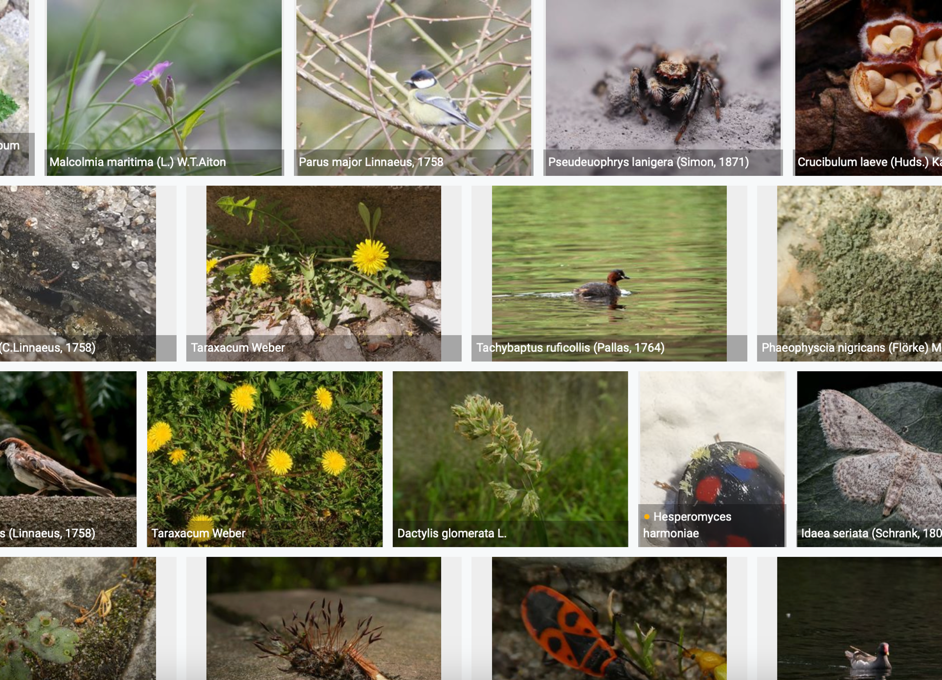
Species occurrence records with multimedia evidence: 2023
1 January 2024
166.4 million records with taxonomically identified images
104.8 million human observations
56.7 million specimens
2.8 million material samples
1.4 million fossil specimens
1,281,667 audio files
8,195 videos
https://www.gbif.org/occurrence/gallery

Slide 4
GBIF Participant countries
1 January 2024
Voting Participants
Associate Participants

Slide 5
GBIF network of data publishing institutions
1 January 2024
142
countries/areas with institutions
sharing data through GBIF
Number of active publishers by country or area

Slide 6
GBIF.org traffic by country: 2023
1 January 2024
Rank | Country/Territory | Visitors | Visits | Effective visits* | % Effective visits | 2022 rank | Pages / visit
1 | United States | 773,254 | 916,812 | 375,893 | 10.71% | 1 | 4.50
2 | Colombia | 350,149 | 451,611 | 221,289 | 6.30% | 2 | 4.38
3 | Brazil | 334,182 | 393,515 | 177,082 | 5.04% | 4 | 4.22
4 | Mexico | 344,338 | 408,154 | 167,343 | 4.77% | 5 | 4.27
5 | Indonesia | 225,758 | 280,575 | 162,774 | 4.64% | 7 | 5.90
6 | France | 324,514 | 387,006 | 158,672 | 4.52% | 9 | 4.42
7 | China | 189,141 | 267,239 | 154,999 | 4.42% | 3 | 10.02
8 | Spain | 248,731 | 315,051 | 154,375 | 4.40% | 6 | 5.97
9 | Germany | 265,968 | 325,439 | 143,193 | 4.08% | 10 | 5.54
10 | India | 273,665 | 308,495 | 114,143 | 3.25% | 11 | 3.55
 | TOTAL | 6,355,4029 | 7,797,044 | 3,508,670 | 100.00% |  | 5.09

Slide 7
Occurrences published by country: 2023
1 January 2024
Rank | Country/Territory | 2023 | 2022 total | 2022 rank
1 | United States | 151,004,708 | 123,152,046 | 1
2 | United Kingdom | 36,220,446 | 14,602,384 | 6
3 | Canada | 22,744,659 | 22,328,115 | 4
4 | Netherlands | 14,293,849 | 30,330,743 | 3
5 | France | 13,208,845 | 40,243,552 | 2
6 | Sweden | 9,339,841 | 13,698,583 | 7
7 | India | 8,543,437 | 7,300,428 | 9
8 | Spain | 7,633,366 | 5,058,667 | 13
9 | Colombia | 7,145,173 | 6,052,455 | 12
10 | Brazil | 4,593,508 | 2,721,541 | 19
OTHER COUNTRIES + AREAS | OTHER COUNTRIES + AREAS | 81,266,325 | 66,653,115
TOTAL |  | 355,993,458 | 369,598,387

Slide 8
Data download requests by country: 2023
1 January 2024
Rank | Country |  | 2023 | 2022 total | 2022 rank
1 | China | 39,253 |  | 36,844 | 1
2 | United States | 34,275 |  | 24,812 | 3
3 | Mexico | 26,051 |  | 27,172 | 2
4 | Colombia | 19,341 |  | 18,392 | 4
5 | Brazil | 18,370 |  | 14,777 | 5
6 | Spain | 13,492 |  | 9,280 | 7
7 | United Kingdom | 10,044 |  | 10,256 | 6
8 | France | 7,248 |  | 5,231 | 9
9 | Canada | 6,649 |  | 4,782 | 10
10 | Germany | 5,788 |  | 4,590 | 11
OTHER COUNTRIES + AREAS | ALL OTHERS | 87,262 |  | 75,107
TOTAL |  | 267,773 |  | 232,591
168
countries, islands & territories where users have ≥5 requested downloads

Slide 9
Peer-reviewed publications using GBIF-mediated data
1 January 2023

Slide 10
Data use in peer-reviewed journals: 2023
1 January 2024
Peer-reviewed uses by country
Peer-reviewed uses by region
End of Year |  |  | 2023 total | 2022 total | 2022 rank
1 | United States |  | 387 | 306 | 2
2 | China |  | 381 | 309 | 1
3 | Brazil |  | 191 | 167 | 3
3 | United Kingdom |  | 182 | 149 | 4
5 | Germany |  | 163 | 126 | 6
6 | Spain |  | 130 | 105 | 7
7 | Mexico |  | 129 | 140 | 5
8 | France |  | 108 | 78 | 8
9 | Australia |  | 94 | 78 | 8
10 | Italy |  | 79 | 66 | 9

Slide 11
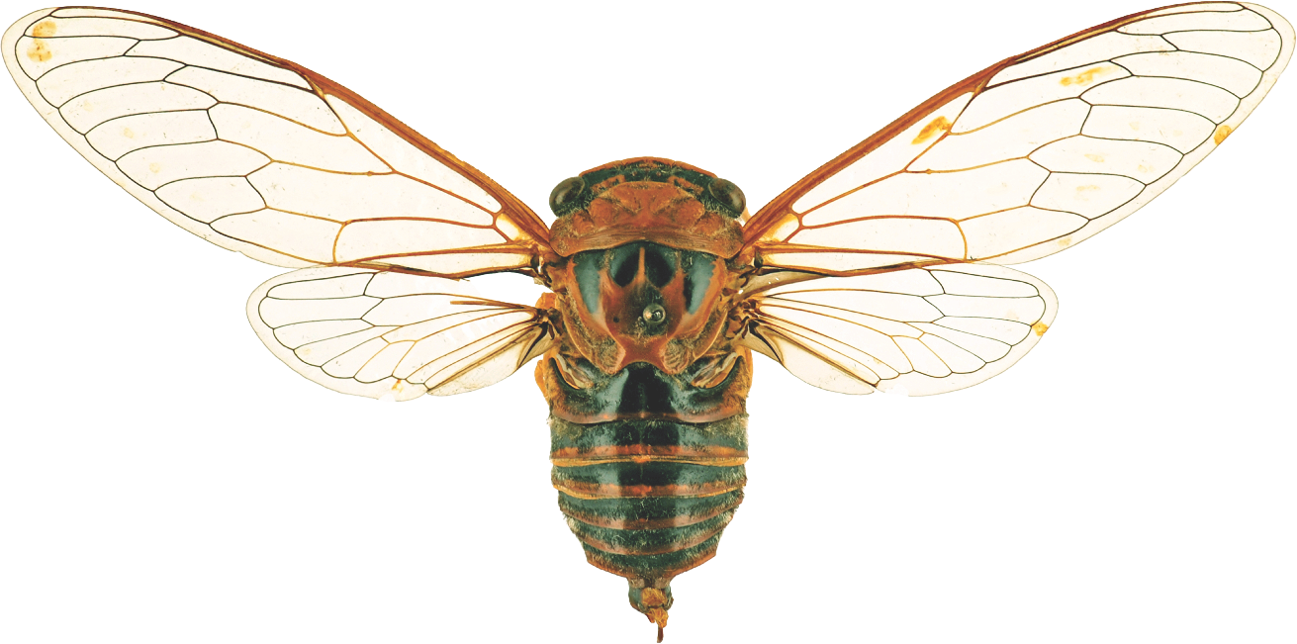
Suggestions reviewed
Institutions
7,864
1,378
vv
Countries
Collections
92
7,403
Country editors
Digitized specimens
52
210,856,531
GRSciColl by the numbers | 25 Jan 2024
gbif.org/scientific-collections

Slide 12
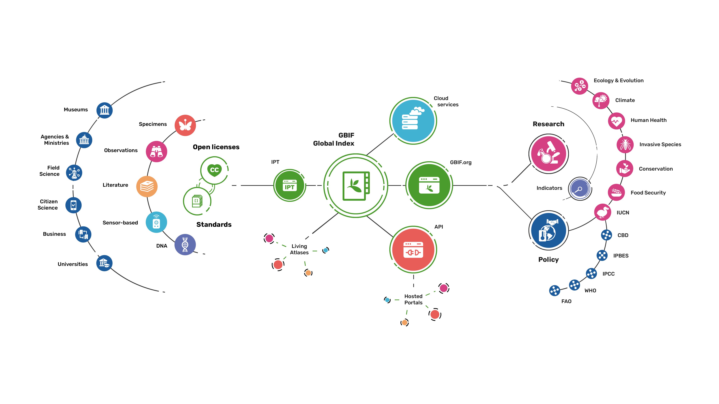
Providing biodiversity evidence for research and policy

Slide 13
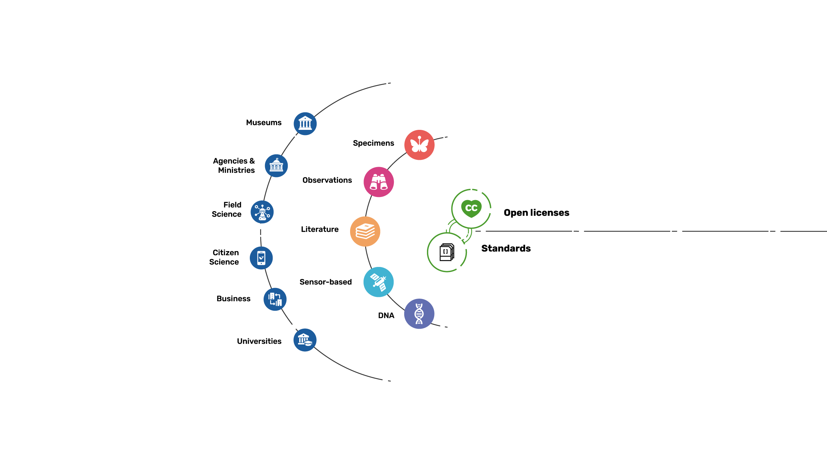
Sources of biodiversity evidence
Create
Combine sources of evidence

Slide 14
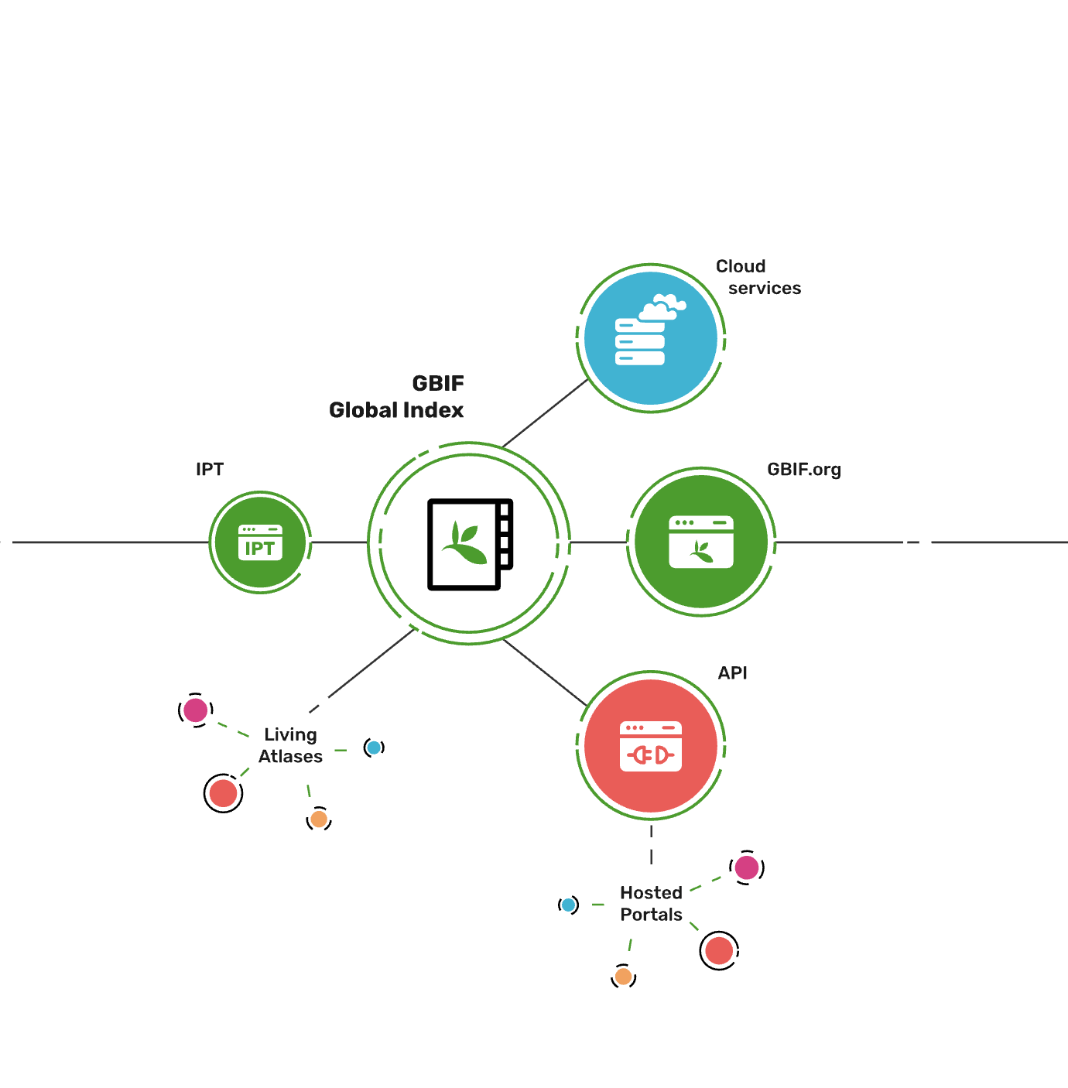
Access to biodiversity evidence
Share
FAIR and open access

Slide 15
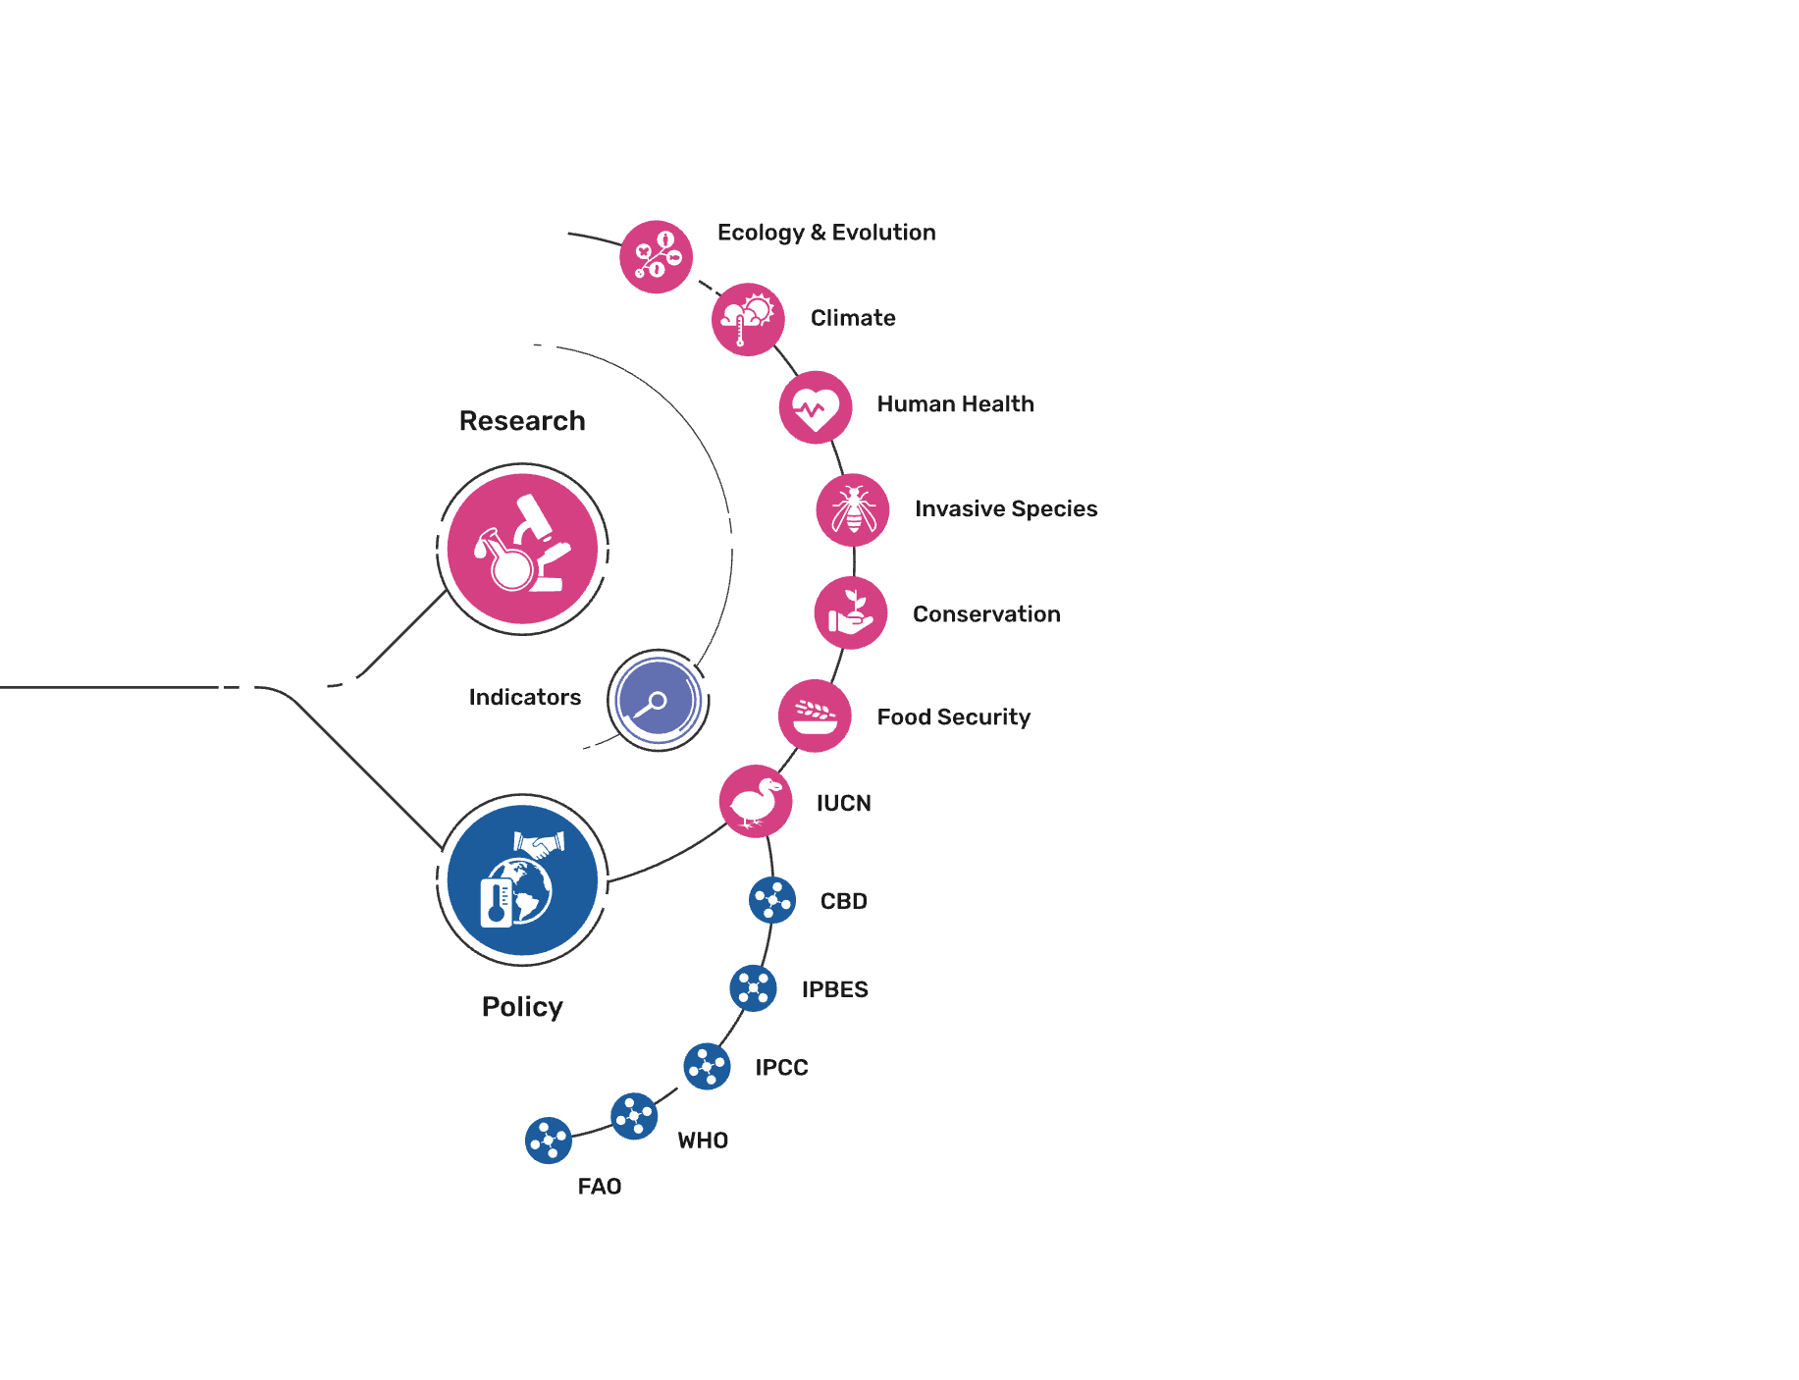
Uses of biodiversity evidence
Transform
Apply and use data

